Slide 1

Global Electronics Sales Performance Analysis
Summary and Recommendations

Slide 2
Strong Initial Performance, But Concerning Recent Trends
Global Electronics achieved $20.67M in revenue, 26K orders, and 12K customers.
Fast average processing time of 4.53 days.
Dominant "Computers" category, driven by brands like "Adventure Works" and "Wide World Importers.“
Significant sales decline observed in 2020 and 2021, requiring immediate attention.

Slide 3
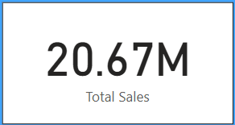
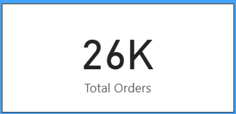
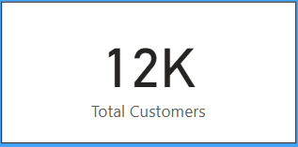
Key Performance Indicators

